Slide 1
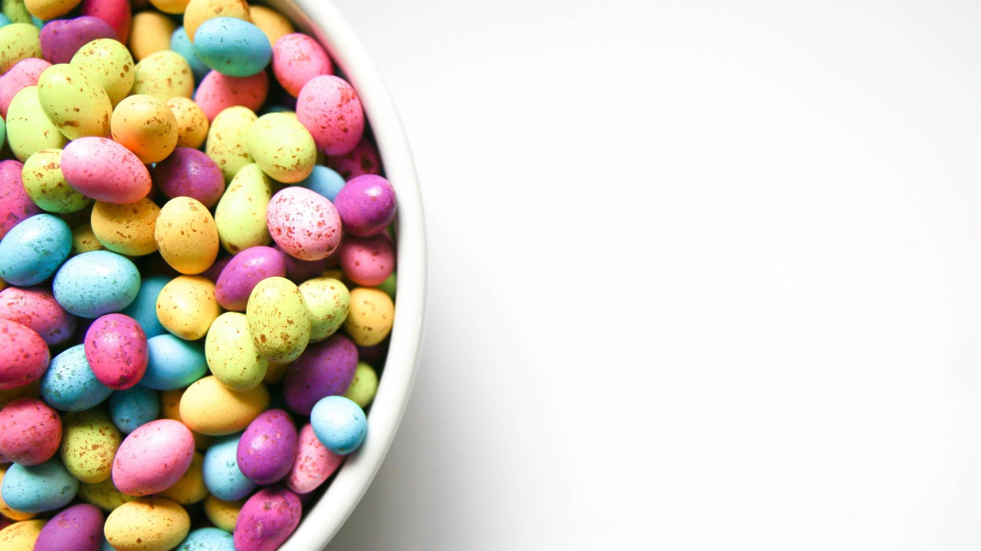
Predicting Favourite
Candies
Exploratory Data Analysis with Machine Learning Model

Slide 2
Favourite Candy Data
Info : Info function of the dataset gives us the following insights:
–Rows/Candy_Varieties: 85
–Columns/Attributes: 13
–dtypes: float(3), int(9), object(1)
•
Describe : On describe of the data we infer that:
–No null value count/missing values in any of the attribute.
–Every candy is a unique record, so no duplicates in the dataset.
–Sugar and Price are given in percentile where as Winning component is given in percentage.

Slide 3
Favourite Candy Data
Data Manipulation:
– Round of the decimals in the sugar percent, price percent and win percent to 3 decimals.
In the competitor Name , we find some special characters like "Õ" instead of "'". Lets replace them in the dataset.
Deriving New Features
–Updating the win percent as win percent/100 in order to maintain all in decimals
–Create 2 new variables sugarbyprice and winbyprice
Sugar by price: higher value means the candy is sweet as well as cheap.
Win by price: higher value means the candy is more liked as well as cheap.

Slide 4
Favourite Candy Data
Data Profiling
–Rows : 85
–Columns: 15 (Bool:9, Num: 5, Cat: 1)
–No Missing Values
–Competitor Name has 85 unique values
–Chocolate and Fruity are the popular compositions.
–Pluribus has equal distribution on chocolates existing in a box.
–sugar percent and price percent has their mean and median almost closer to each other, hence we infer that, they both are normally distributed.
–win percent has median slightly less than the mean, hence we infer that, win percent is right skewed a little.

Slide 5
EDA on Candy Data Set

Slide 6
Distribution of Each Compositions of Candies

Slide 7
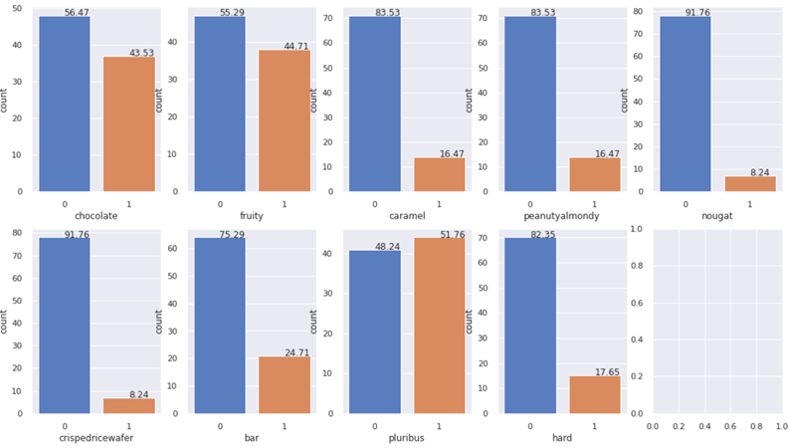
Inference: In the given 85 varieties of candies:
Chocolaty - 43.53%
Fruity - 44.71%
Pluribus - 51.76%
(from a Box of Candies)
Soft Candies - 82.35%

Slide 8
Most and Least Popular Candies
(Top 20)

Slide 9
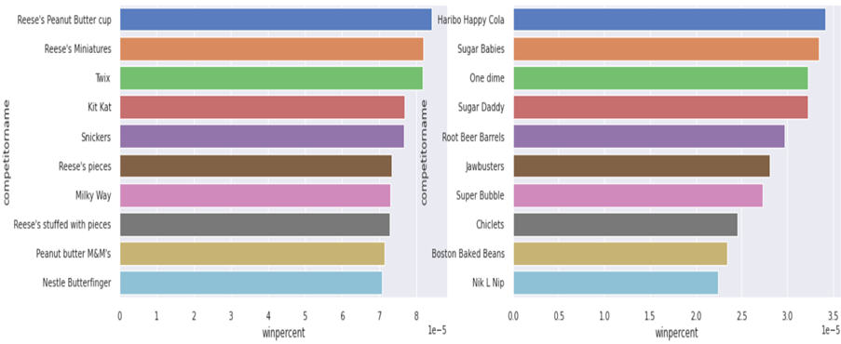
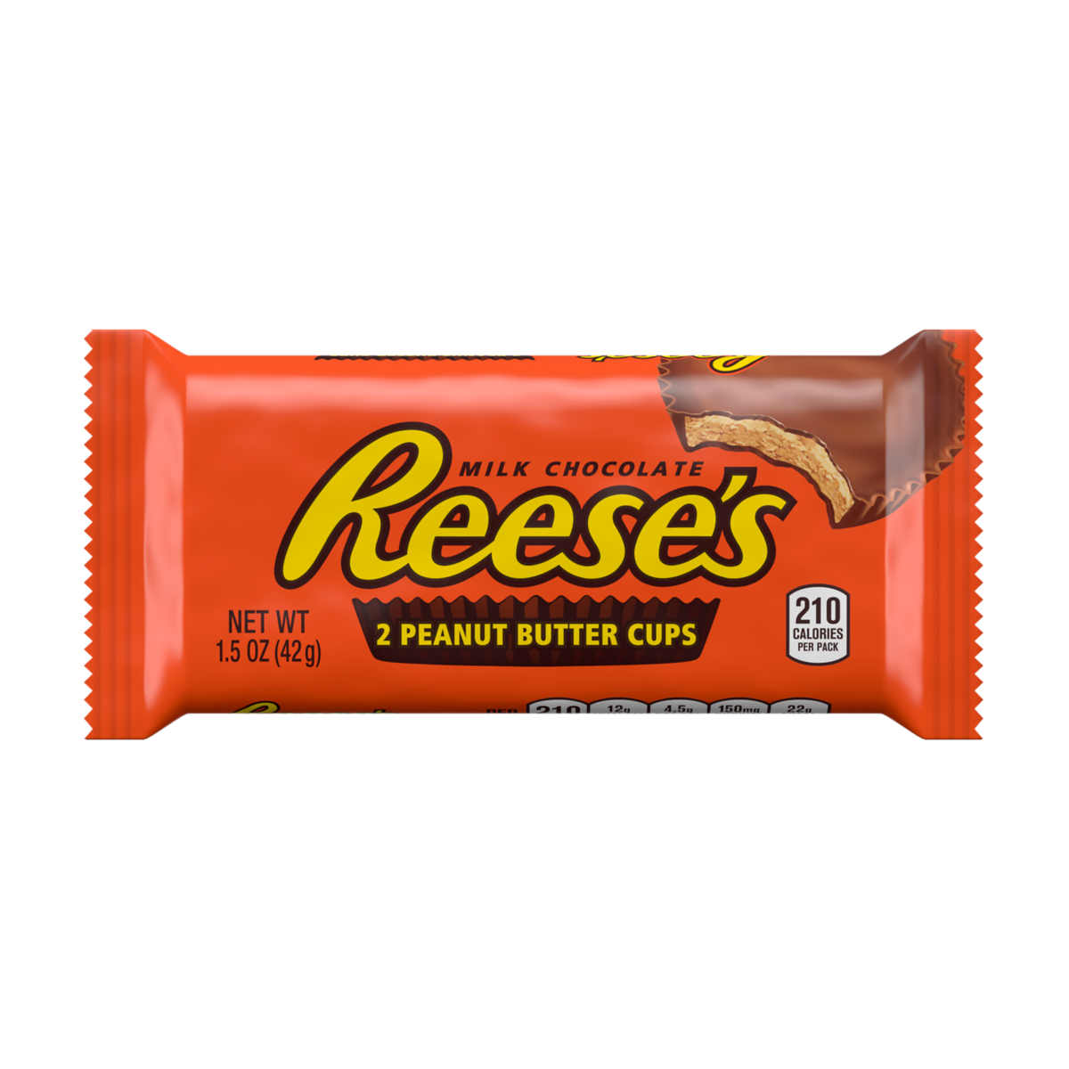
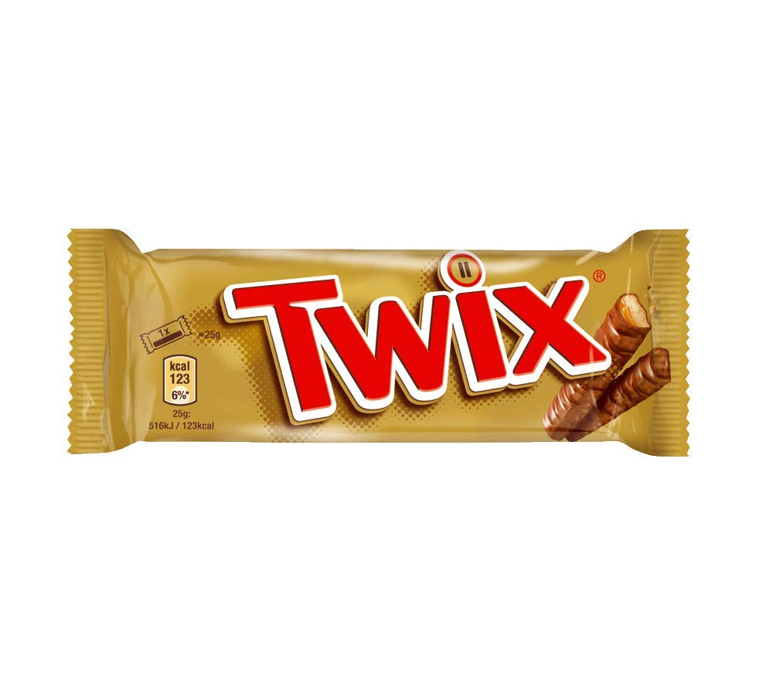
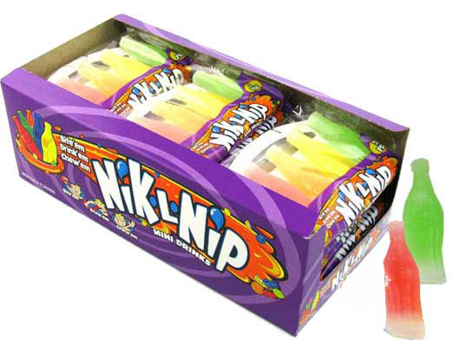
Inference:
Most Popular
Reese's Peanut Butter cup,
Miniatures and
Twix
Inference:
Least Popular
- Nik L Nip, Boston Baked Beans and Chiclets are the least popular candies

Slide 10
Composition of Top 20 Popular Candies

Slide 11
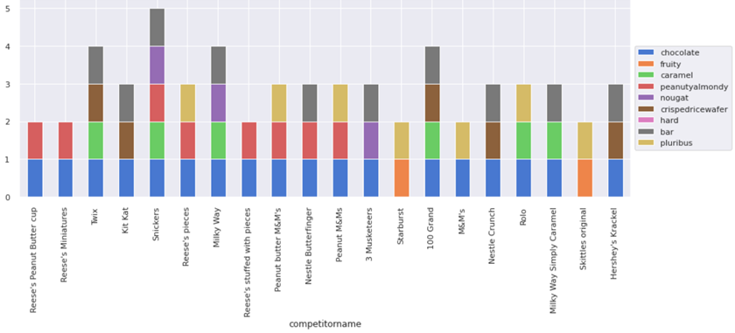
Inference:
Most of the top 20 Popular candies are
Chocolaty bar type and Soft in texture

Slide 12
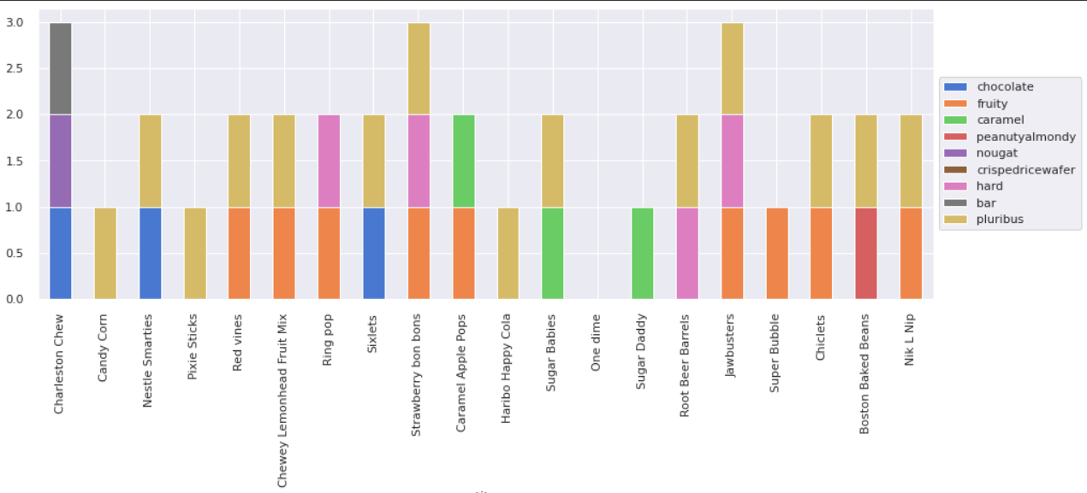
Inference:
Most of the top 20 Least Popular candies are
Pluribus type candies with mixture of fruity composition

Slide 13
Top 20 Popular Candies other than Chocolate

Slide 14
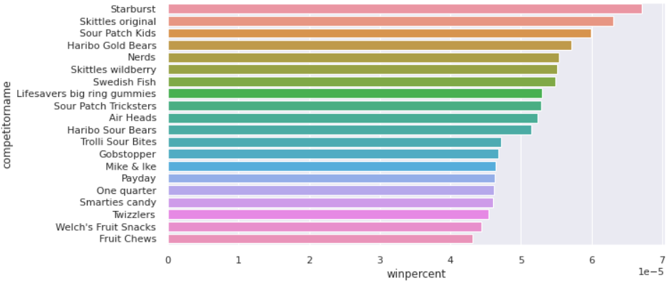
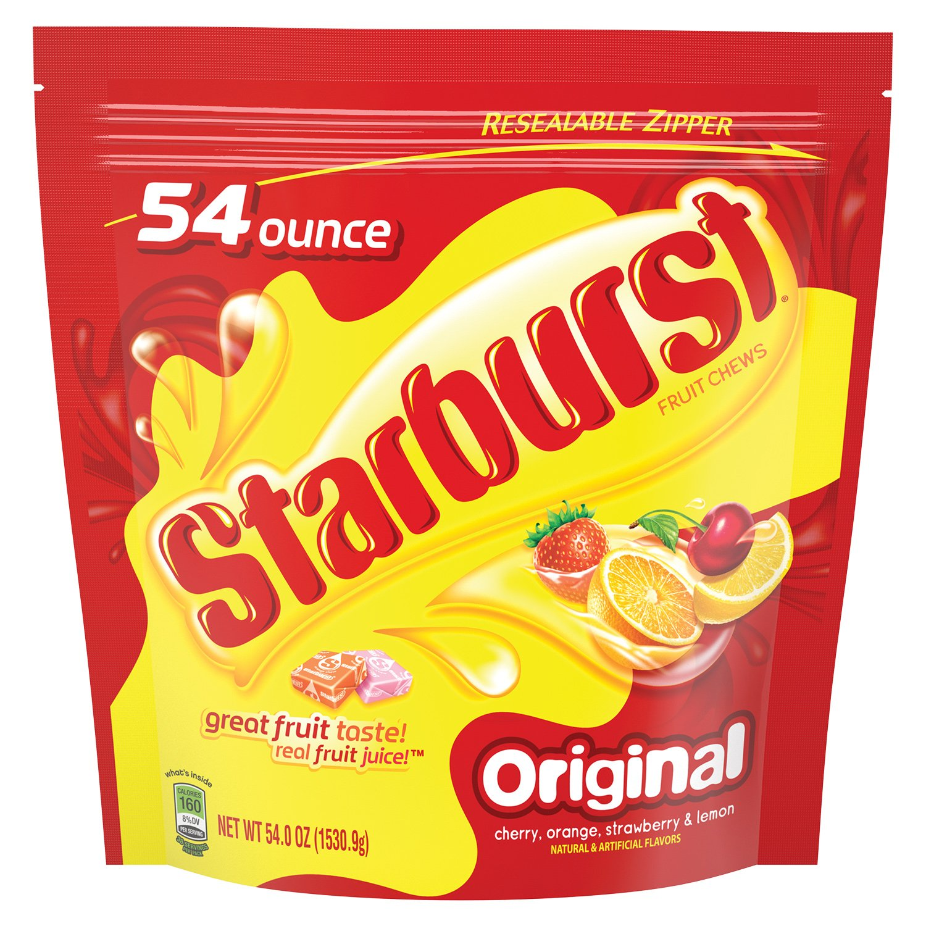
Inference:
Starburst
Skittles original
Sour Patch kids

Slide 15
Composition of the Top 20 Popular Candies other than Chocolaty

Slide 16
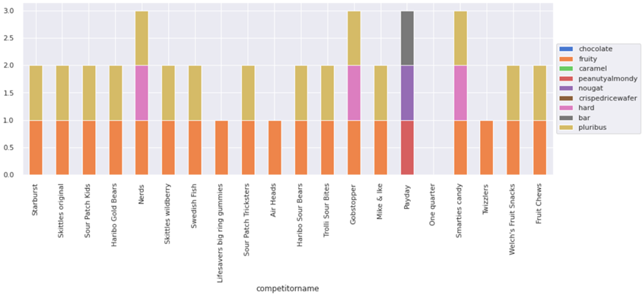
Inference:
In the top 20 popular non chocolaty candies most of them are fruity and are of pluribus type. We even note (One Quarter) candy which does not have any composition of these types.

Slide 17
Top 20 Costly Candies

Slide 18
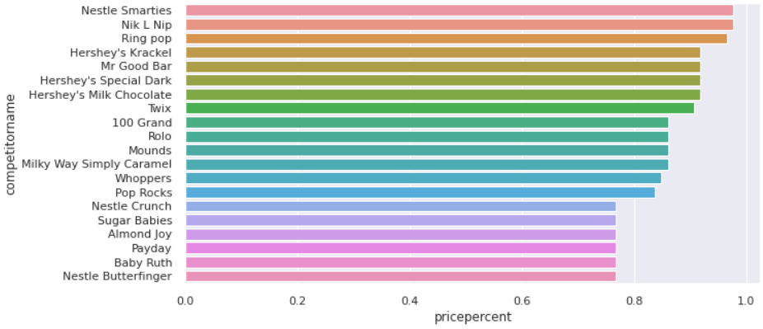
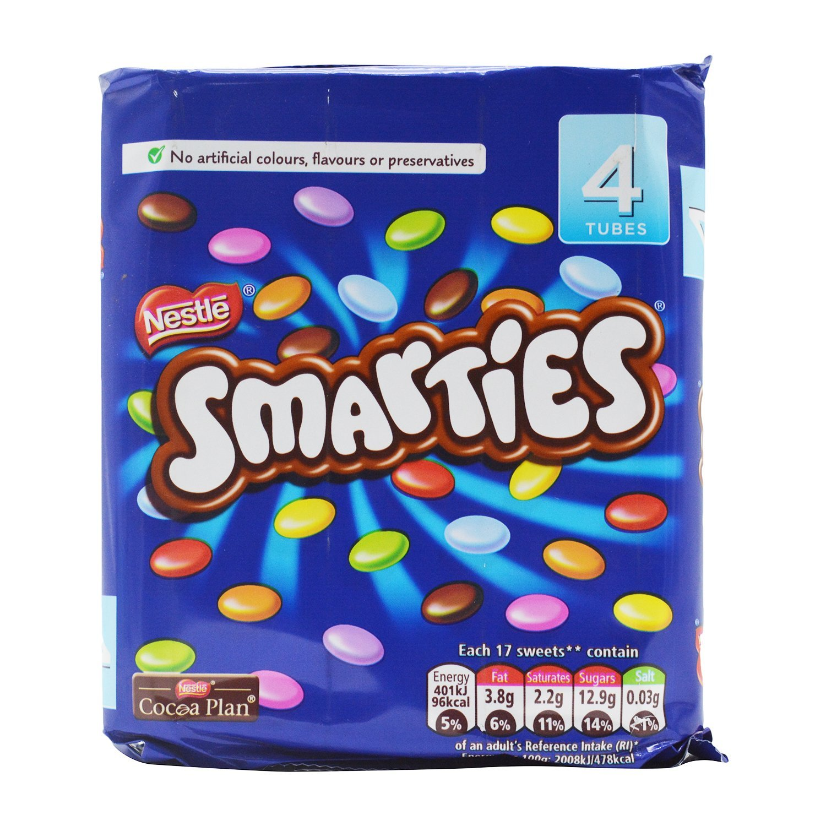
Inference:
Nestle Smarties
Nik L Nip
Ring pop
Are the costliest candies.
we saw that Nik L Nip is the least popular candies of the lot in the given dataset

Slide 19
Composition of Top 20 Costly Candies

Slide 20
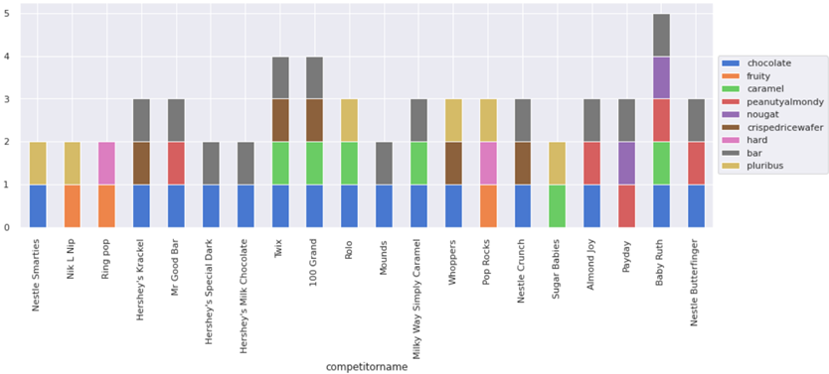
Inference:
In the top 20 costly candies, we find that most of them are chocolaty and are of bar type

Slide 21
Top 20 Costliest Candies other than Chocolaty

Slide 22
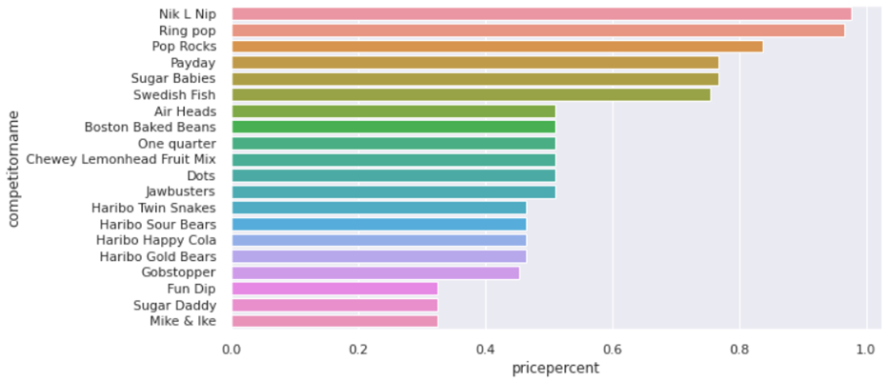
Inference:
Nik L Nip
Ring pop
Pop Rocks
Nik L Nip seems to be the non chocolaty, least popular and a very costly candy.

Slide 23
Composition of the Top 20 Costliest Candies other than Chocolaty

Slide 24
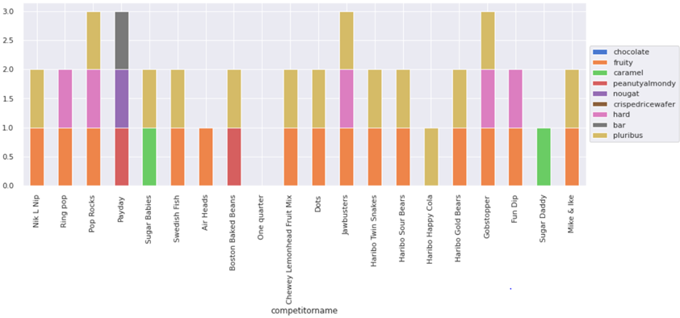
Inference:
In the top 20 Costliest non chocolaty candies most of them are fruity and are of pluribus type.

Slide 25
Top 20 Sugary Candies

Slide 26
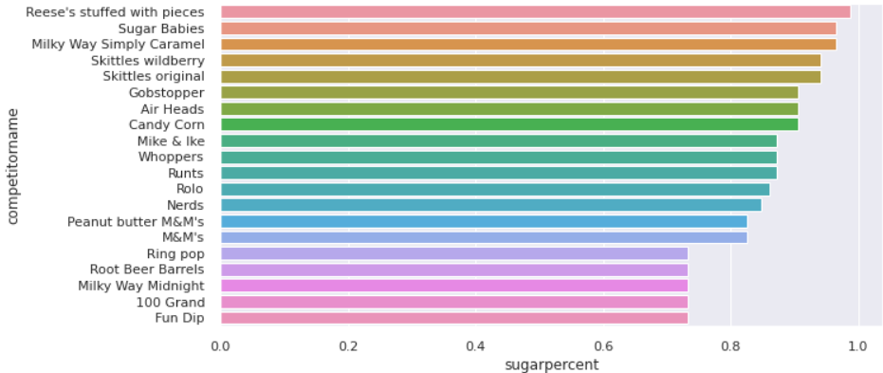
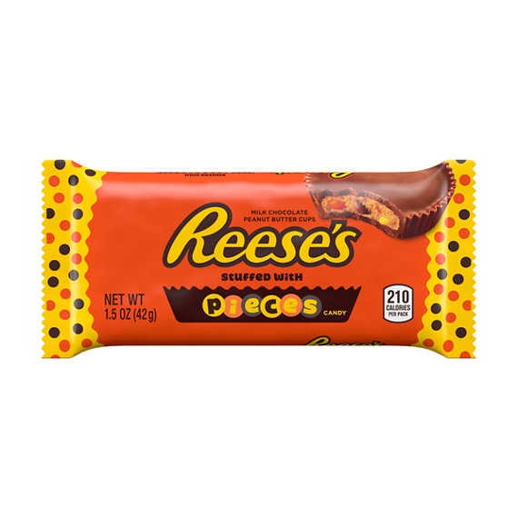
Inference:
Reese’s Stuffed with pieces
Sugar babies
Milky way simply caramel

Slide 27
Composition of Top 20 Sugary Candies

Slide 28
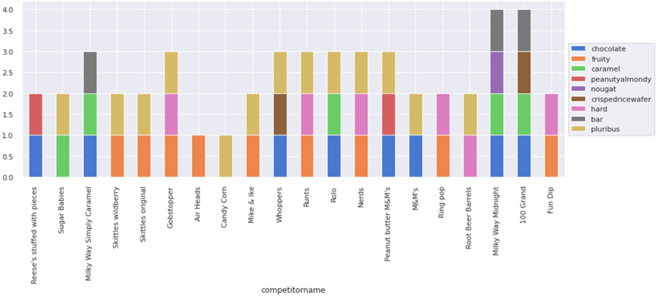
Inference:
In the top 20 sugary candies, most of them are either chocolaty or fruity and are of pluribus type.

Slide 29
Top 20 Cheap Popular Candies

Slide 30
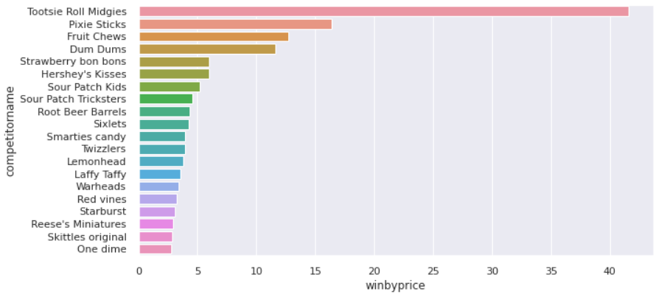
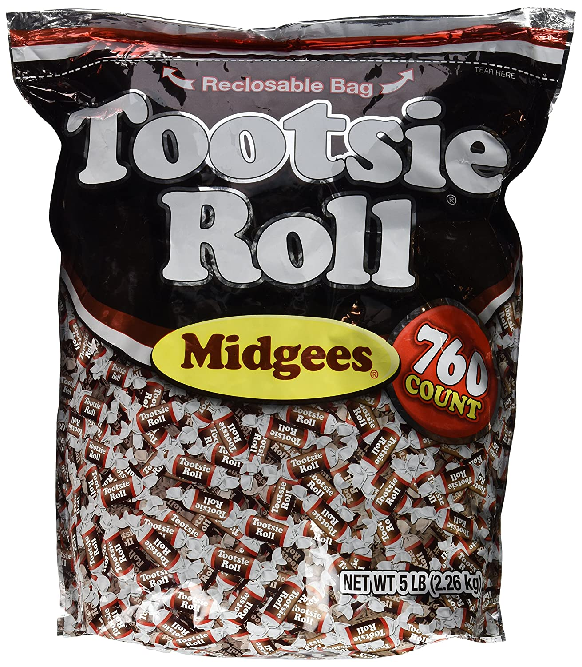
Inference:
Tootsie Roll Midgies seems to be the popular chocolaty candy which is cheap as well.

Slide 31
Composition of Top 20 Cheap Popular Candies

Slide 32
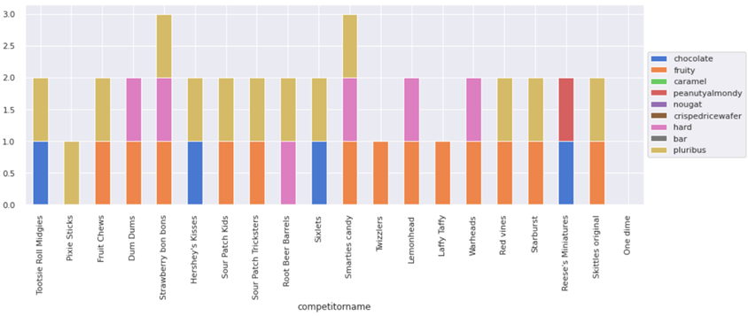
Inference:
The top 20 popular and cheap candies, are mostly of fruity and pluribus type.

Slide 33
Top 20 Cheap Sugary Candies

Slide 34
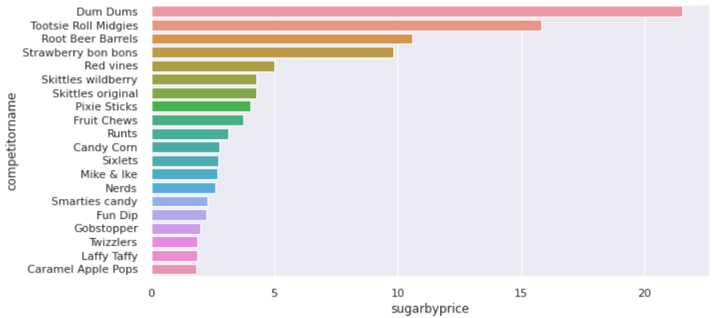
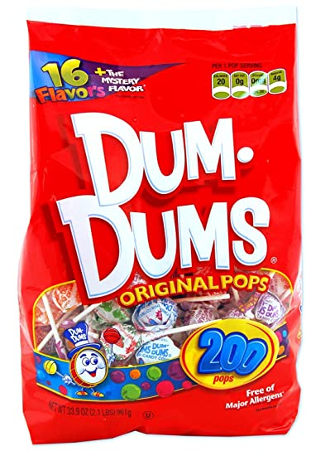
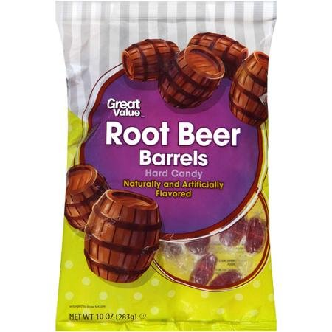
Inference:
Dum Dums, Tootsie Roll Midgies, Root Beer Barrels are the top sugary and cheap candies.

Slide 35
Composition of Top 20 Cheap Sugary Candies

Slide 36
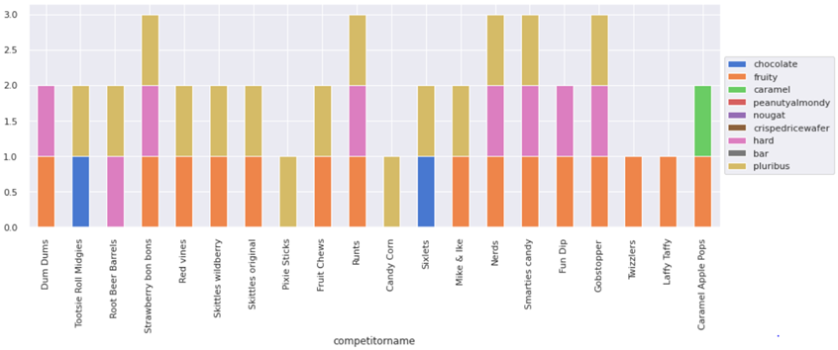
Inference:
The top 20 sugary and cheap candies are mostly fruity and of pluribus type.

Slide 37
Candies Composition & win percent

Slide 38
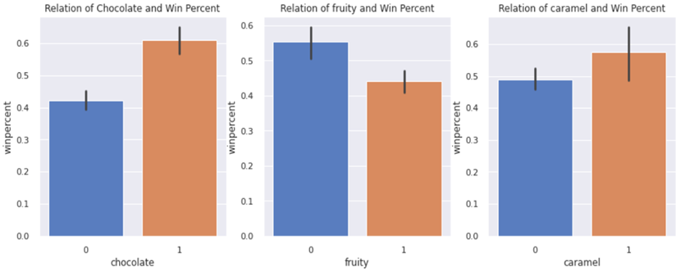
Inference:
More than 60% of the population likes candies which are chocolaty.
More than 55% of the population likes candies which has caramel.
More than 55% of the population likes candies which are not fruity.

Slide 39
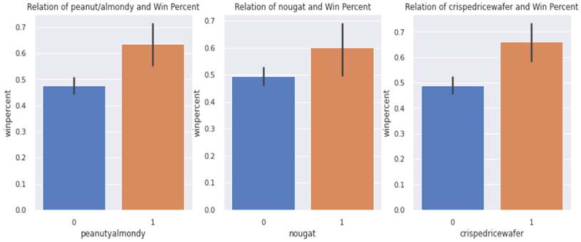
Inference:
More than 60% of the population likes candies which have peanuts and almonds.
More than 60% of the population likes candies which are of nougats.
More than 60% of the population likes candies which are of crispedricewafer.

Slide 40
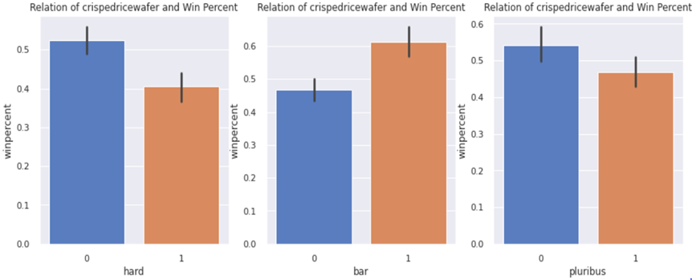
Inference:
More than 60% of population likes bar type candies.
More than 40% of population likes hard type candies and which are from a box of candies(pluribus)
In this question we conclude that, every composition in the candy adds up to the win percentage, hence we shall consider all the compositions for the machine learning algorithm.

Slide 41
Sugar percent and Price percent varies with win percent

Slide 42
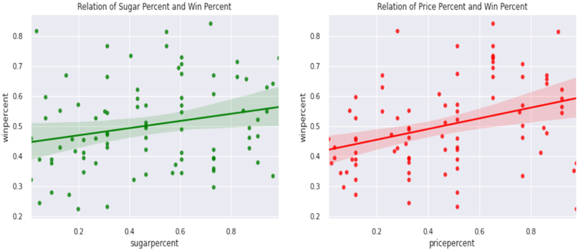
Inference:
All the data points are scattered in both the graphs hence:
Sugar percent is very weakly correlated to win percent which means that the sugar content of candy doesn't contribute to the popularity of the candy.
Price percent is very weakly correlated to win percent which means that the cost of
candy doesn't contribute to the popularity of the candy.

Slide 43
Most Frequently used Composition

Slide 44
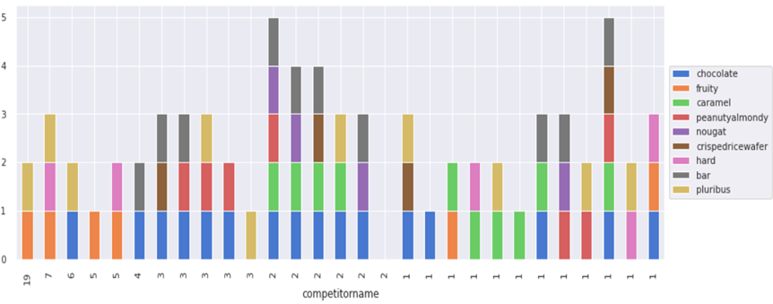
Inference:
Most frequently used combination of compositions in the 85 different candies are:
Fruity and Pluribus
Fruity, Hard and Pluribus
Chocolate and bar

Slide 45
Candies Correlation of Compositions

Slide 46
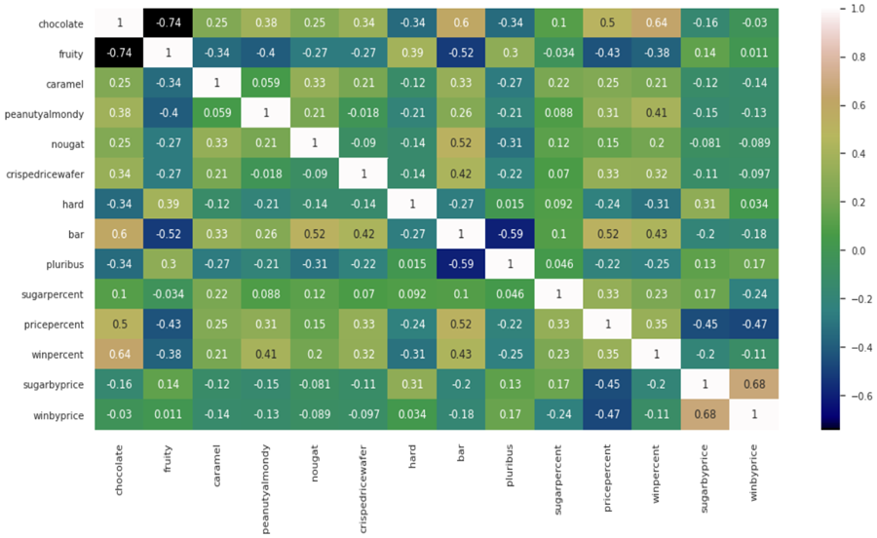

Slide 47
Inference:
Sugarbyprice and winbyprice are highly co-related (0.68). The more the candy is sweeter and cheaper, the more it is likely to be popular.
Chocolate and winpercent are highly cor-related (0.64). The more the candy is chocolatey, the more it is likely to be popular.
Chocolate and bar are highly correlated (0.6). Mostly the candies which are chocolatey are of bar type.
Pricepercent and bar are medium correlated (0.52). Mostly the bar type candies are costlier than the other candies.
Chocolatey and Fruity are negatively correlated (-0.74). Mostly Chocolatey candies does not have fruity composition.
Bar and pluribus are negatively cor-related (-0.52). Mostly bar types candies are not of pluribus type(they are not from a box of candies)
Bar and fruity are negatively cor-related (-0.52). Mostly bar types candies are not of fruity.

Slide 48

Conclusions from EDA
In the given 85 varieties of candies:
43.53% of them are chocolaty
44.71% of them are fruity
51.76% of them are pluribus(from a box of candies)
82.35% of them are soft candies
In the top 20 popular candies:
Reese's Peanut Butter cup, Miniatures and Twix are the most popular candies.
Most of the candies are chocolaty, bar type and soft in texture.
In the top 20 non chocolaty popular candies:
Starburst, Skittles original and Sour Patch kids candies tops the winning list which are not chocolaty.
Most of the candies are fruity and are of pluribus type.

Slide 49
Conclusions from EDA
In the top 20 costly candies:
Nestle Smarties, Nik L Nip , Ring pop are the most costliest candies.
Most of the candies are chocolaty and are of bar type.
In the top 20 non chocolaty costly candies:
Most of the candies are fruity and are of pluribus type.
In the top 20 sugary candies:
Reese's stuffed with pieces, Sugar Babies , Milky Way Simply Caramel are the top sugary candies.
Most of the candies are either chocolaty or fruity and are of pluribus type.

Slide 50
Conclusions from EDA
In the top 20 candies which are popular and cheap:
Tootsie Roll Midgies seems to be the popular chocolaty candy which is cheap as well.
Most of the candies are fruity and are of pluribus type.
In the top 20 candies which are sugary and cheap:
Dum Dums, Tootsie Roll Midgies, Root Beer Barrels are the top sugary and cheap candies.
Mostly the candies are fruity and of pluribus type.

Slide 51
Conclusions from EDA
Sugar and Price percent relation with Winperecnt:
Sugar percent is not linear to win percent which means that the sugar content of candy doesn't contribute to the popularity of the candy.
Price percent is not linear to win percent which means that the cost of
candy doesn't contribute to the popularity of the candy.
Most frequently used combination of compositions in the 85 different candies are:
Fruity and Pluribus
Fruity, Hard and Pluribus
Chocolate and bar

Slide 52

Conclusions from EDA
Every composition in the candy adds up to the win percentage, hence we shall consider all the compositions for the machine learning algorithm.

Slide 53
Popular Candy Prediction

Slide 54
Model Assumptions

Slide 55
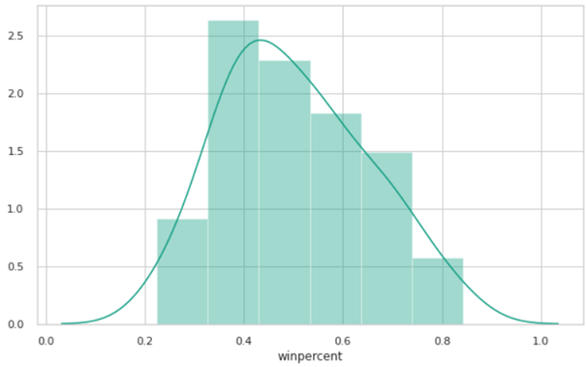
Assumption 1 : Target Variable should be normally distributed
Inference:
We see that the target variable winpercent is normally distributed. Assumption 1 is satisfied.

Slide 56
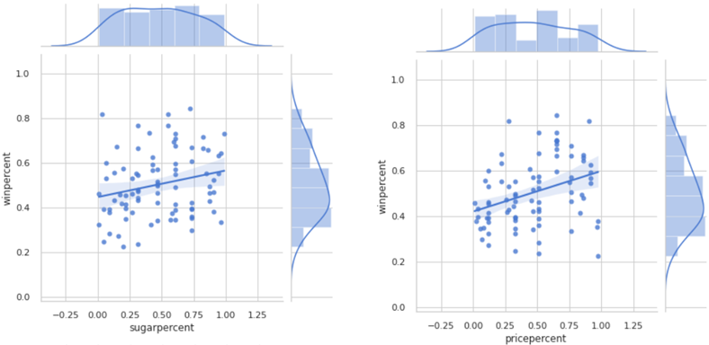
Assumption 2 : Linear Relation should be possible between Target Variable and Explanatory Variables:
Inference:
We find that, sugarpercent, pricepercent are all linear but very weakly correlated with the target variable winpercent.

Slide 57
Scaling of Explanatory Variables

Slide 58
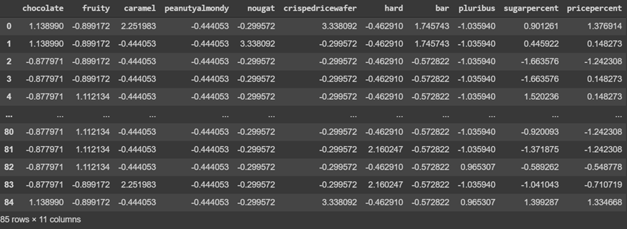
In our candy dataset, we have :
Categorical data: All the compositions are categorical (1 or 0 - binary form).
Numerical data: Sugarpercent, Pricepercent are in numerical continuous form (values between 0-1), hence we need to scale the data before we predict for the winpercent of a candy.

Slide 59
Feature Selection

Slide 60
In the given explanatory variables in the dataset, since the sugarpercent and pricepercent were weakly correlated to the winpercent of a candy, I have divided the features for model predictions into 2 types, as given below and will be applying various regression models.-
Target Variable is ‘winpercent’.
Feature Type 1:
['chocolate', 'fruity', 'caramel', 'peanutyalmondy','nougat', 'crispedricewafer', 'hard', 'bar', 'pluribus']
Feature Type 2:
['chocolate', 'fruity', 'caramel', 'peanutyalmondy','nougat', 'crispedricewafer', 'hard', 'bar', 'pluribus', 'sugarpercent','pricepercent']
Since the Target variable is continuous, we shall use the regression models for prediction. The possible regression models which can be applied as learnt from ML basics are:
Linear Regression
Decision Tree Regression
Pruned Decision Tree Regression
Decision Tree Regression with Grid SearchCV
Random Forest Regression
Parameterized Random Forest Regression
Random Forest Regression with Randomized SearchCV
Cross Validation: I have divided the dataset in to 70:30 for the train and test data.

Slide 61
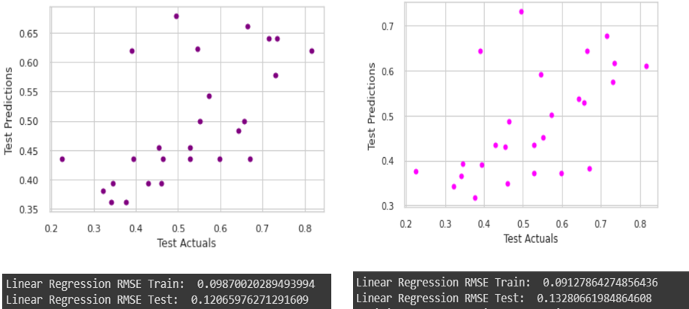
Linear Regression – Actual vs Predicted – RMSE Values
Feature Type 1: Test data predictions
Feature Type 2: Test data predictions

Slide 62
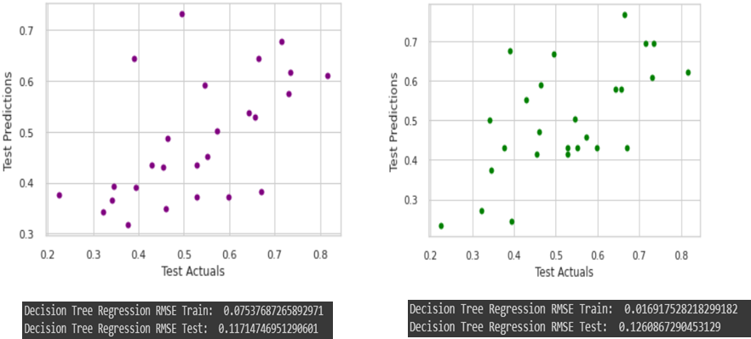
Decision Tree Regression – Actuals vs Predicted – RMSE Values
Feature Type 1: Test data predictions
Feature Type 2: Test data predictions

Slide 63
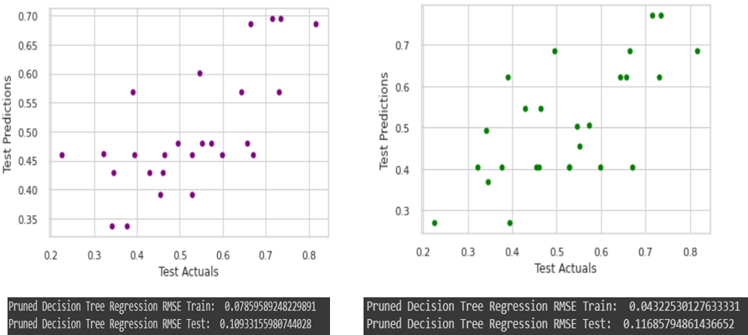
Pruned Decision Tree Regression – Actuals vs Predicted – RMSE Values
Feature Type 1: Test data predictions
Feature Type 2: Test data predictions

Slide 64
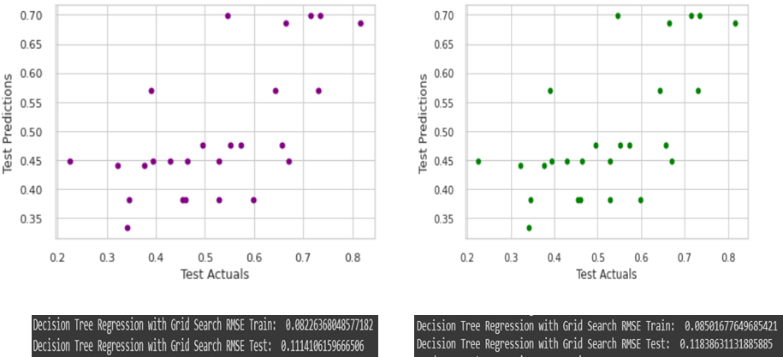
Decision Tree Regression with Grid Search – Actuals vs Predicted – RMSE Values
Feature Type 1: Test data predictions
Feature Type 2: Test data predictions

Slide 65
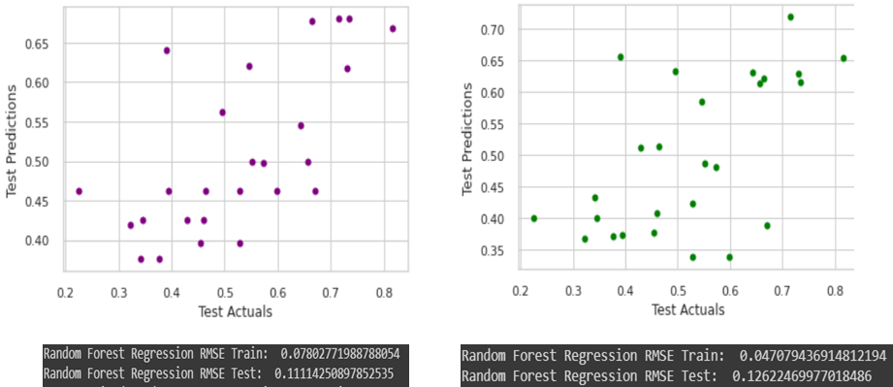
Random forest Regression – Actuals vs Predicted – RMSE Values
Feature Type 1: Test data predictions
Feature Type 2: Test data predictions

Slide 66
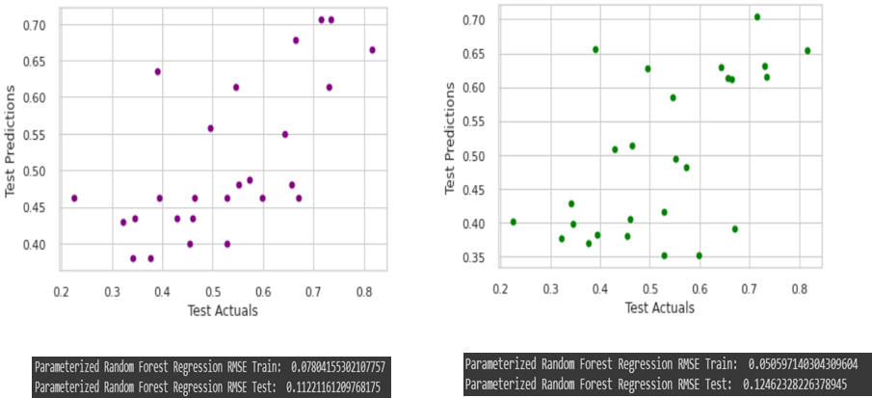
Parameterized Random forest Regression – Actual vs Predicted – RMSE Values
Feature Type 1: Test data predictions
Feature Type 2: Test data predictions

Slide 67
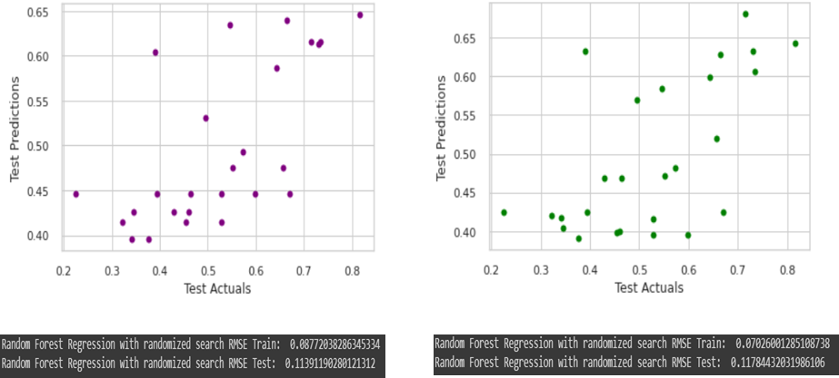
Random forest Regression with Randomized Search – Actual vs Predicted – RMSE Values
Feature Type 1: Test data predictions
Feature Type 2: Test data predictions

Slide 68
Evaluation Metrics for various models

Slide 69
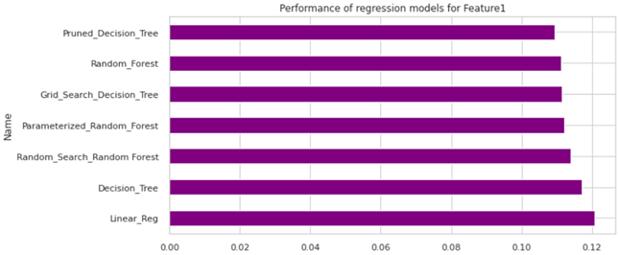
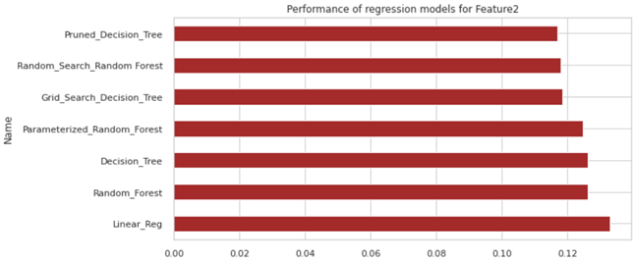
Feature Type 1: Test data predictions
Feature Type 2: Test data predictions

Slide 70
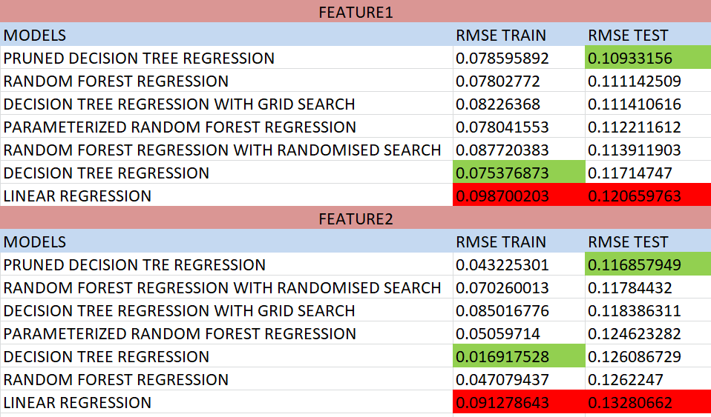
Conclusion
From the RMSE values of various models, we find that the Pruned Decision Tree Regression has the minimum RMSE in both Feature Type 1 and Feature Type 2 predictions.

Slide 71
Thanking you

